Slide 1
Trento, 02 December 2020
Ph.D. Student: Chiara Nardin
chiara.nardin@unitn.it
Introduction
Performance Based Earthquake Engineering
Ph.D. Student Chiara Nardin – M.Sc., Eng. in Civil Engineering
https://github.com/kia13nn/ISPS.git

Slide 2
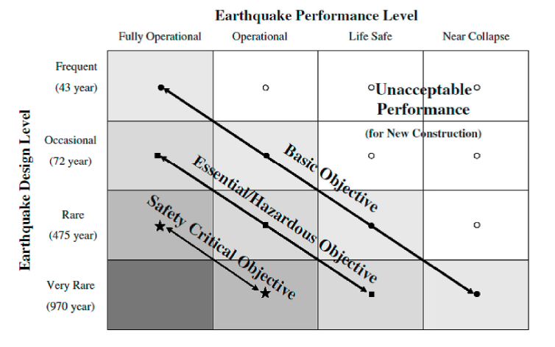
Trento, 02 December 2020
Ph.D. Student: Chiara Nardin
chiara.nardin@unitn.it
Introduction | Probabilistic Hazard Analysis | Fragility Analysis | References
PBEE: Performance Based Earthquake Engineering
Probabilistic framework for (i) assessing design, (ii) evaluation and (iii) planning of civil system.
load-and-resistence-factor design (LRFD)
performance based design (PBD):
3Ds – i.e. downtime, dollars, death
2 axes define the domain of acceptable system’s response:
System performance objectives
Seismic hazard level, w.r.t. return periods
Fig.1 – PBEE concept: seismic performance objectives vs seismic hazard level. ©Poland et al.,(1995)-Vision 2000: Performance Based Earthquake Engineering of buildings. Structural Engineers Association of California, Sacramento, CA.

Slide 3
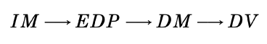
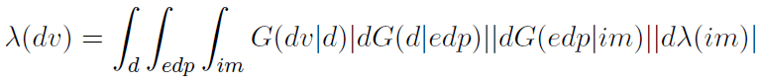

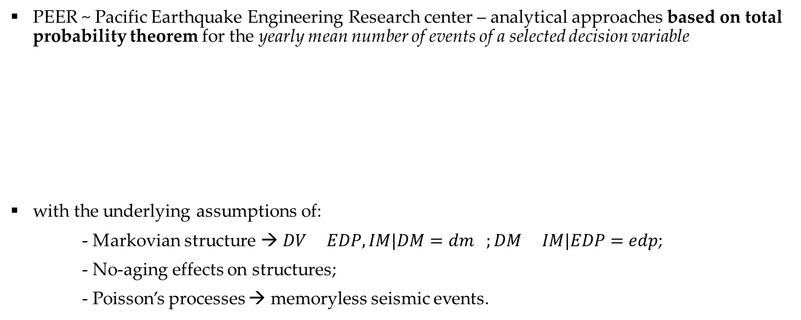
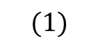
Trento, 02 December 2020
Ph.D. Student: Chiara Nardin
chiara.nardin@unitn.it
Introduction | Probabilistic Hazard Analysis | Fragility Analysis | References
The PEER-PBEE Framework
PEER ~ Pacific Earthquake Engineering Research center – analytical approaches based on total probability theorem for the yearly mean number of events of a selected decision variable
with the underlying assumptions of:
- Markovian structure → $DV EDP,IM|DM=dm ;DM IM|EDP=edp$;
- No-aging effects on structures;
- Poisson’s processes → memoryless seismic events.
$$(1)$$

Slide 4
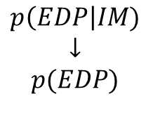
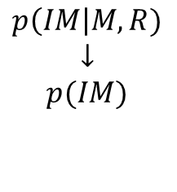
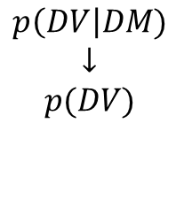
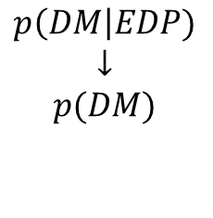
Trento, 02 December 2020
Ph.D. Student: Chiara Nardin
chiara.nardin@unitn.it
Introduction | Probabilistic Hazard Analysis | Fragility Analysis | References
The PEER-PBEE Framework
Hazard analysis
intensity measure
Loss analysis
decision variable
HAZARD
VULNERABILITY
Damage analysis
damage measure
DECISION MAKING
VULNERABILITY
Vulnerability analysis
engineering demand par.
(i) hazard analysis
(ii) fragility analysis
(iii) damage analysis
(iv) loss analysis
$$p\left(IM\right|M,R)$$
$$↓$$
$$p(IM)$$
$$p\left(EDP\right|IM)$$
$$↓$$
$$p(EDP)$$
$$p\left(DM\right|EDP)$$
$$↓$$
$$p(DM)$$
$$p\left(DV\right|DM)$$
$$↓$$
$$p(DV)$$

Slide 5
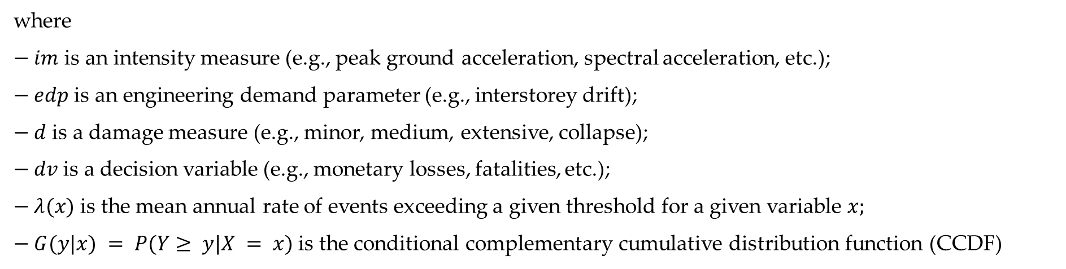
Trento, 02 December 2020
Ph.D. Student: Chiara Nardin
chiara.nardin@unitn.it
Introduction | Probabilistic Hazard Analysis | Fragility Analysis | References
The PEER-PBEE Framework
where
$− im$ is an intensity measure (e.g., peak ground acceleration, spectral acceleration, etc.);
$− edp$ is an engineering demand parameter (e.g., interstorey drift);
$− d$ is a damage measure (e.g., minor, medium, extensive, collapse);
$− dv$ is a decision variable (e.g., monetary losses, fatalities, etc.);
$− λ(x)$ is the mean annual rate of events exceeding a given threshold for a given variable $x;$
$− G(y|x) = P(Y≥ y|X = x)$ is the conditional complementary cumulative distribution function (CCDF)

Slide 6
Trento, 02 December 2020
Ph.D. Student: Chiara Nardin
chiara.nardin@unitn.it
Probabilistic Hazard Analysis
Formulation and MatLab Computation
Ph.D. Student Chiara Nardin – M.Sc., Eng. in Civil Engineering
https://github.com/kia13nn/ISPS.git

Slide 7
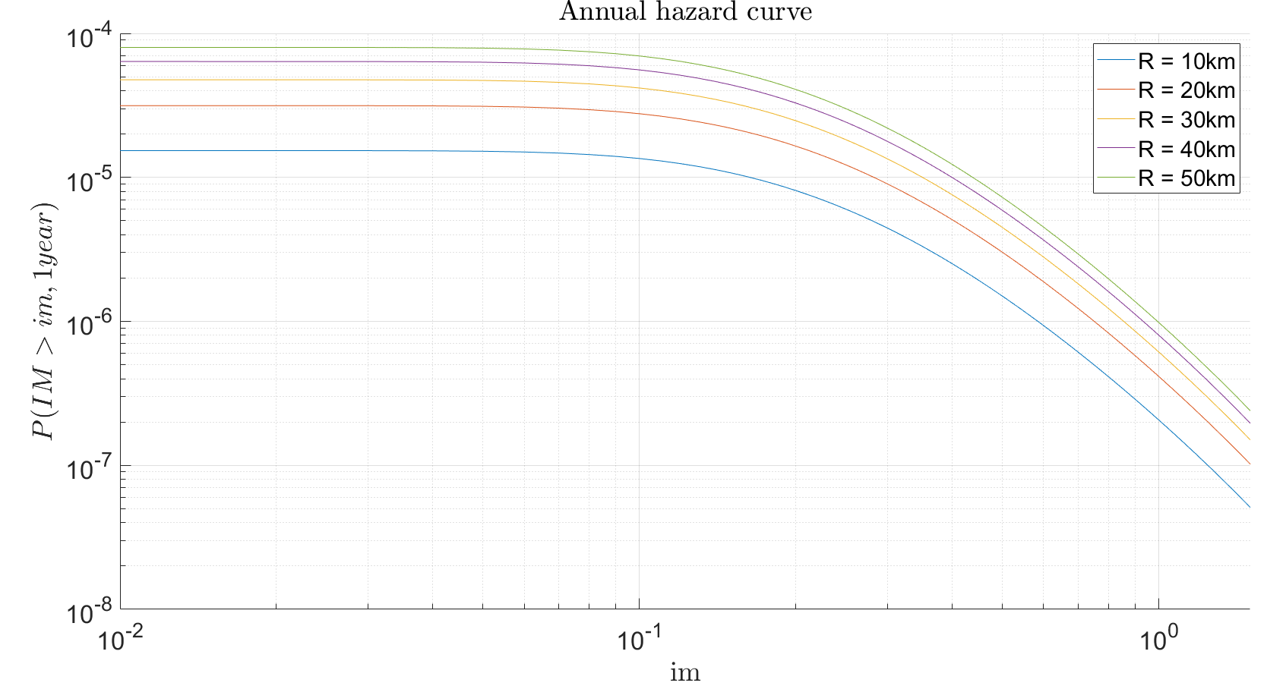
Trento, 02 December 2020
Ph.D. Student: Chiara Nardin
chiara.nardin@unitn.it
Introduction | Probabilistic Hazard Analysis | Fragility Analysis | References
Step 4: Hazard Computation
Goal and results
Through the scheme depicted in (1), compute:
the annual hazard curve for each fault;
the 50 years hazard curve for each fault;
the 475 years hazard curve for each fault
for the highlighted seismic site.

Slide 8
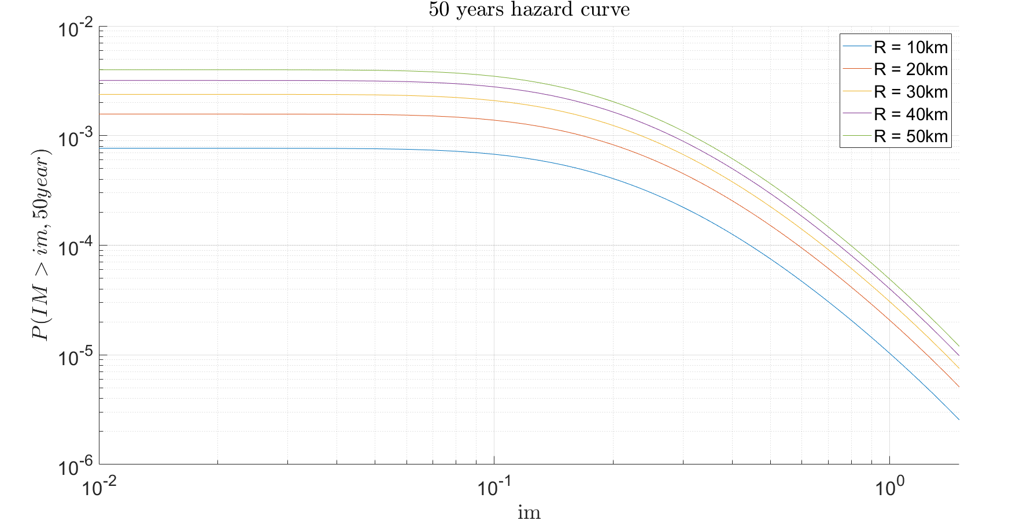
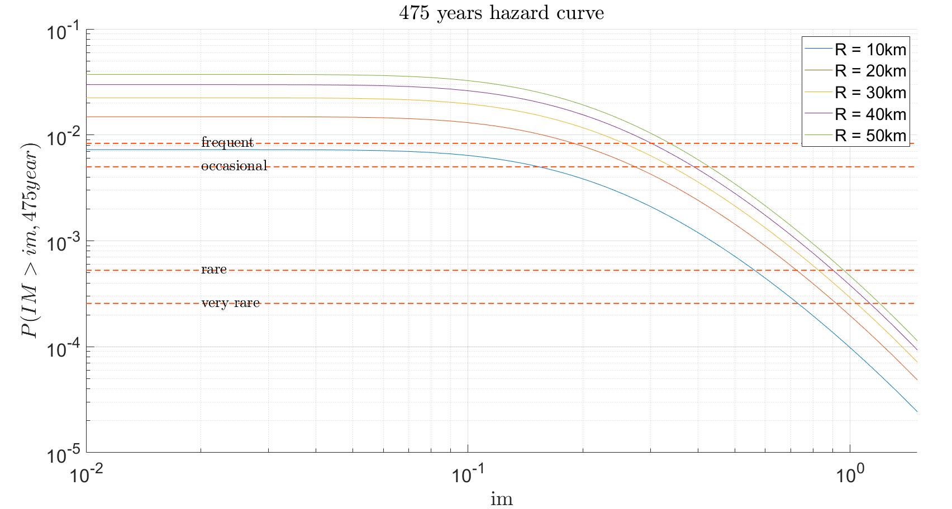
Trento, 02 December 2020
Ph.D. Student: Chiara Nardin
chiara.nardin@unitn.it
Introduction | Probabilistic Hazard Analysis | Fragility Analysis | References
Step 4: Hazard Computation

Slide 9
Trento, 02 December 2020
Ph.D. Student: Chiara Nardin
chiara.nardin@unitn.it
Fragility Analysis
Formulation and MatLab Computation
Ph.D. Student Chiara Nardin – M.Sc., Eng. in Civil Engineering
https://github.com/kia13nn/ISPS.git

Slide 10
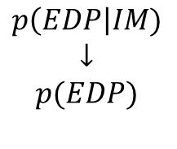
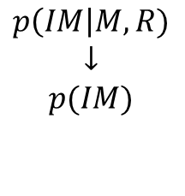
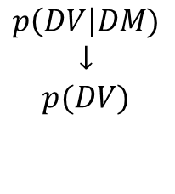
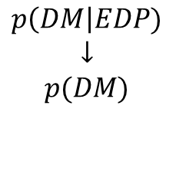
Trento, 02 December 2020
Ph.D. Student: Chiara Nardin
chiara.nardin@unitn.it
Introduction | Probabilistic Hazard Analysis | Fragility Analysis | References
Fragility Analysis
Hazard analysis
intensity measure
Loss analysis
decision variable
HAZARD
VULNERABILITY
Damage analysis
damage measure
DECISION MAKING
VULNERABILITY
Vulnerability analysis
engineering demand par.
Fragility (or Vulnerability) Analysis is the second step of the PBEE-PEER framework
Useful definitions:
seismic fragility function := the conditional probability of an event (e.g. a defined limit/damage state) given the observation of an intensity measure which describe the seismic event.
$$p\left(IM\right|M,R)$$
$$↓$$
$$p(IM)$$
$$p\left(EDP\right|IM)$$
$$↓$$
$$p(EDP)$$
$$p\left(DM\right|EDP)$$
$$↓$$
$$p(DM)$$
$$p\left(DV\right|DM)$$
$$↓$$
$$p(DV)$$

Slide 11
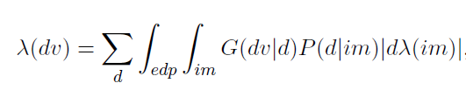
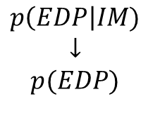
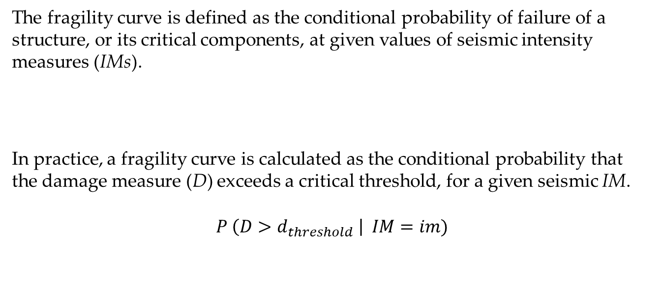
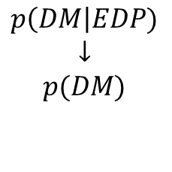
Trento, 02 December 2020
Ph.D. Student: Chiara Nardin
chiara.nardin@unitn.it
Introduction | Probabilistic Hazard Analysis | Fragility Analysis | References
Fragility Analysis
Vulnerability analysis
engineering demand par.
The fragility curve is defined as the conditional probability of failure of a structure, or its critical components, at given values of seismic intensity measures (IMs).
In practice, a fragility curve is calculated as the conditional probability that the damage measure (D) exceeds a critical threshold, for a given seismic IM.
$$P \left(D>d_{threshold} \right| IM=im)$$
VULNERABILITY
$$p\left(EDP\right|IM)$$
$$↓$$
$$p(EDP)$$
Damage analysis
damage measure
VULNERABILITY
$$p\left(DM\right|EDP)$$
$$↓$$
$$p(DM)$$

Slide 12
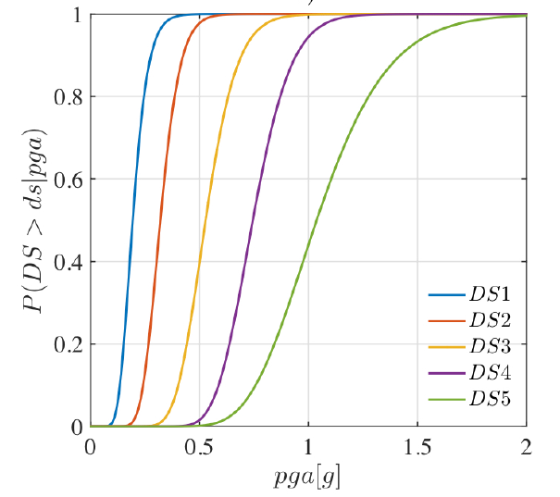
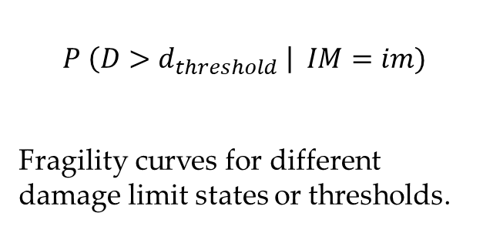
Trento, 02 December 2020
Ph.D. Student: Chiara Nardin
chiara.nardin@unitn.it
Introduction | Probabilistic Hazard Analysis | Fragility Analysis | References
Fragility Analysis
Vulnerability analysis
engineering demand par.
$$P \left(D>d_{threshold} \right| IM=im)$$
Fragility curves for different damage limit states or thresholds.
VULNERABILITY
$$p\left(EDP\right|IM)$$
$$↓$$
$$p(EDP)$$
Damage analysis
damage measure
VULNERABILITY
$$p\left(DM\right|EDP)$$
$$↓$$
$$p(DM)$$

Slide 13
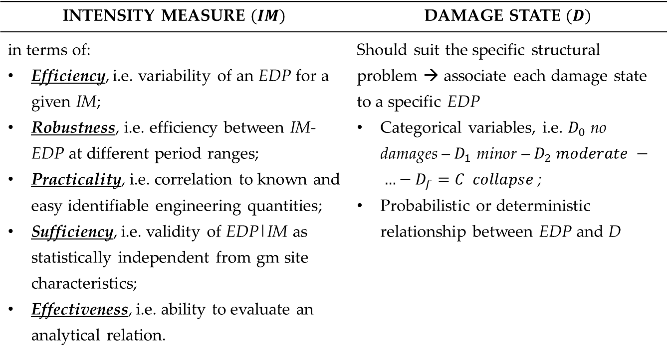
Trento, 02 December 2020
Ph.D. Student: Chiara Nardin
chiara.nardin@unitn.it
Introduction | Probabilistic Hazard Analysis | Fragility Analysis | References
Fragility Analysis: key aspects
Vulnerability analysis
engineering demand par.
INTENSITY MEASURE $(IM)$ | DAMAGE STATE $(D)$
in terms of: Efficiency, i.e. variability of an EDP for a given IM; Robustness, i.e. efficiency between IM-EDP at different period ranges; Practicality, i.e. correlation to known and easy identifiable engineering quantities; Sufficiency, i.e. validity of EDP|IM as statistically independent from gm site characteristics; Effectiveness, i.e. ability to evaluate an analytical relation. | Should suit the specific structural problem → associate each damage state to a specific EDP Categorical variables, i.e. $D_{0}$ no damages – $D_{1}$ minor – $D_{2} moderate − …−D_{f}=C collapse$; Probabilistic or deterministic relationship between EDP and D
VULNERABILITY
$$p\left(EDP\right|IM)$$
$$↓$$
$$p(EDP)$$
Damage analysis
damage measure
VULNERABILITY
$$p\left(DM\right|EDP)$$
$$↓$$
$$p(DM)$$

Slide 14
Trento, 02 December 2020
Ph.D. Student: Chiara Nardin
chiara.nardin@unitn.it
Introduction | Probabilistic Hazard Analysis | Fragility Analysis | References
Class of fragilities
EMPIRICAL | ANALYTICAL | EXPERT OPINION | HYBRID
by fitting a function to observational data from past earthquakes or lab tests collections pairs of level of excitation and categorical variables of damage or collapse | by defining analytical structural model and analyzing its performance under different levels of the seismic hazard static, i.e. hazard as response spectrum and push-over analysis vs dynamic, i.e. collection of gms and simulations on FEM via NLA | by polling one or more experts of the given structural asset to guess or estimate the failure probability for a given hazard level | based on combination of the different methods

Slide 15
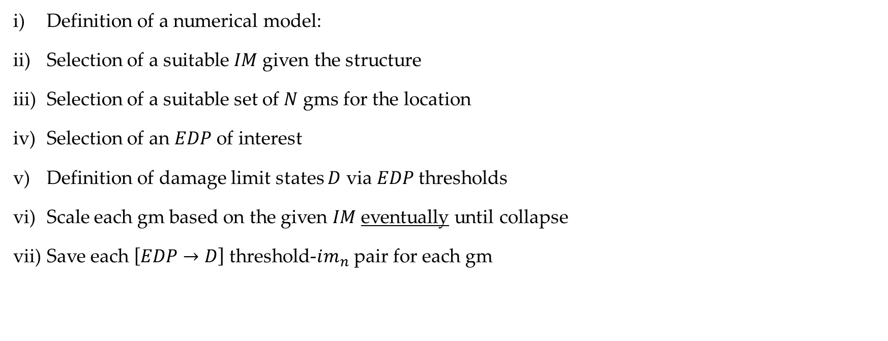
Trento, 02 December 2020
Ph.D. Student: Chiara Nardin
chiara.nardin@unitn.it
Introduction | Probabilistic Hazard Analysis | Fragility Analysis | References
Dynamic based fragility functions: steps
Definition of a numerical model:
Selection of a suitable $IM$given the structure
Selection of a suitable set of $N$ gms for the location
Selection of an $EDP$ of interest
Definition of damage limit states $D$ via $EDP$thresholds
Scale each gm based on the given $IM$eventually until collapse
Save each $\left[EDP→D\right]$ threshold-$im_{n}$ pair for each gm
Full IDA
Truncated IDA

Slide 16
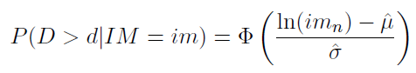
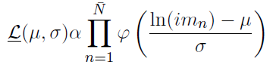
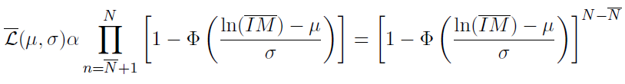
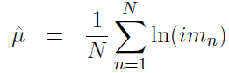
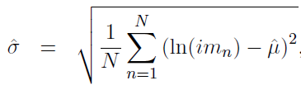
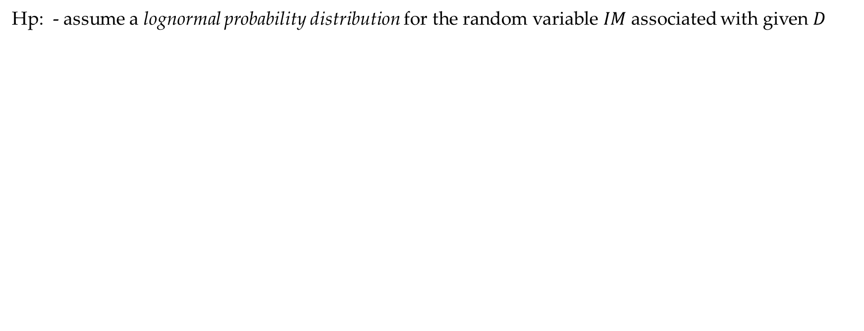
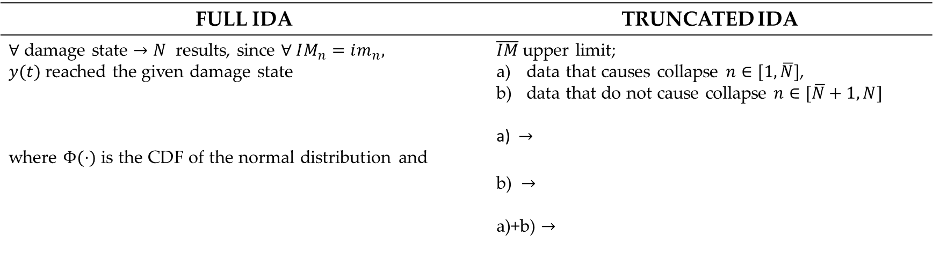
Trento, 02 December 2020
Ph.D. Student: Chiara Nardin
chiara.nardin@unitn.it
Introduction | Probabilistic Hazard Analysis | Fragility Analysis | References
Computation of fragility function
Hp: - assume a lognormal probability distribution for the random variable $IM$ associated with given $D$
FULL IDA | TRUNCATED IDA
$∀$ damage state $→N$ results, since $∀ IM_{n}=im_{n}, y(t)$reached the given damage state where $Φ(⋅)$ is the CDF of the normal distribution and | $\overline{IM}$upper limit; data that causes collapse $n∈[1,\overline{N}]$, data that do not cause collapse $n∈[\overline{N}+1,N]$ a) $→$ b) $→$ a)+b) $→$

Slide 17
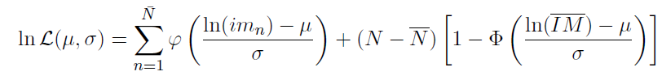
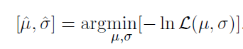
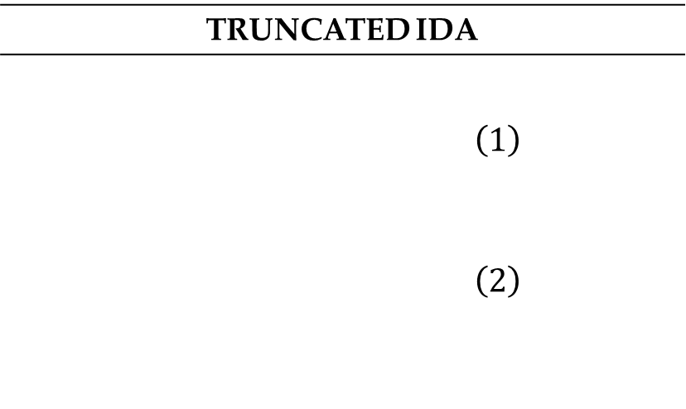
Trento, 02 December 2020
Ph.D. Student: Chiara Nardin
chiara.nardin@unitn.it
Introduction | Probabilistic Hazard Analysis | Fragility Analysis | References
Computation of fragility function
TRUNCATED IDA
$$\left(1\right)$$ $$\left(2\right)$$
The likelihood for the entire set of data
And the log likelihood
Estimation of parameters by optimization

Slide 18
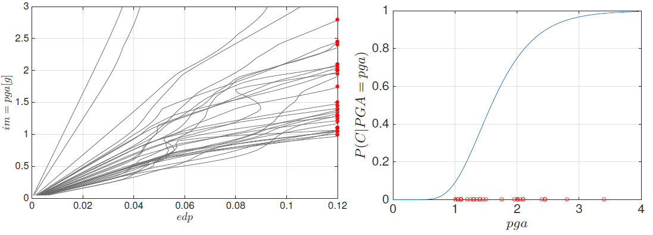
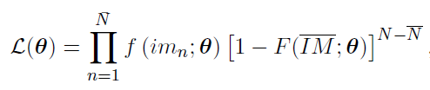
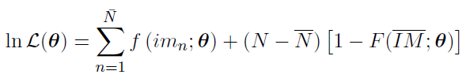
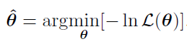
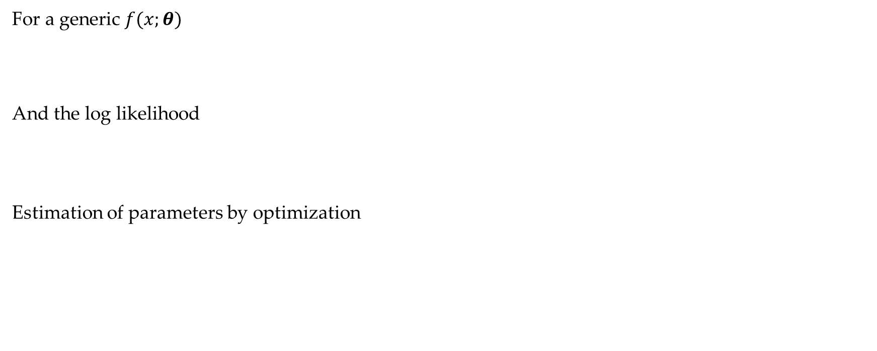
Trento, 02 December 2020
Ph.D. Student: Chiara Nardin
chiara.nardin@unitn.it
Introduction | Probabilistic Hazard Analysis | Fragility Analysis | References
Computation of fragility function
For a generic $f(x;θ)$
And the log likelihood
Estimation of parameters by optimization
Fig.1 – Fragility function computed via IDA, see Broccardo, M. (2018) Probabilistic seismic risk analysis for civil systems, Lecture Notes.

Slide 19
Trento, 02 December 2020
Ph.D. Student: Chiara Nardin
chiara.nardin@unitn.it
Fragility Analysis
Formulation and MatLab Computation
Ph.D. Student Chiara Nardin – M.Sc., Eng. in Civil Engineering
https://github.com/kia13nn/ISPS.git

Slide 20
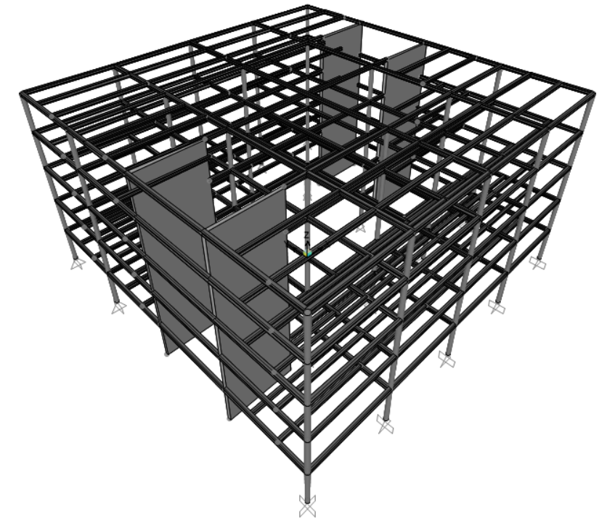
Trento, 02 December 2020
Ph.D. Student: Chiara Nardin
chiara.nardin@unitn.it
Introduction | Probabilistic Hazard Analysis | Fragility Analysis | References
Goal: to perform fragility analysis
Given the provided set of ground motions, perform a classical and truncated incremental dynamic analysis (IDA) and determine fragility curves for:
ATTEL – moment resistant frame (MRF);
ATTEL – braced frame (BF)
by considering both
Linear elastic behaviour
Bouc – Wen model for hysteresis
3D model of the case study ATTEL – SERA project.

Slide 21
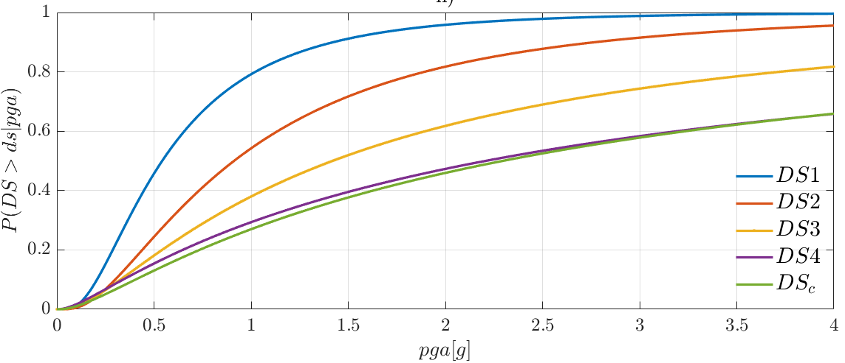
Trento, 02 December 2020
Ph.D. Student: Chiara Nardin
chiara.nardin@unitn.it
Introduction | Probabilistic Hazard Analysis | Fragility Analysis | References
Main steps:
Definition of the numerical model
Input and IM selection
Definition of damage limit states and reference EDP
Performing non-linear time histories analysis (IDA, truncated IDA, cloud, MSA …)
Collecting results pairs and computing fragility
3D model of the case study ATTEL – SERA project.

Slide 22
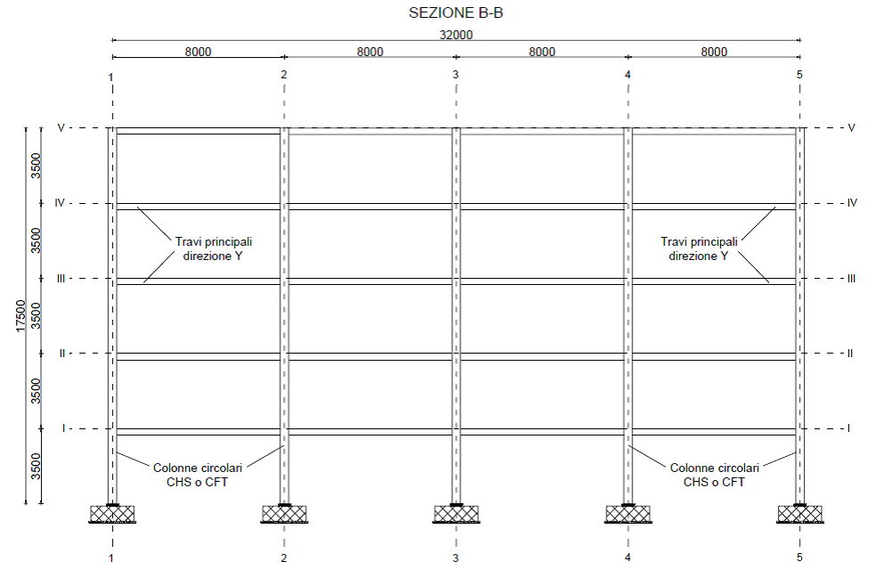
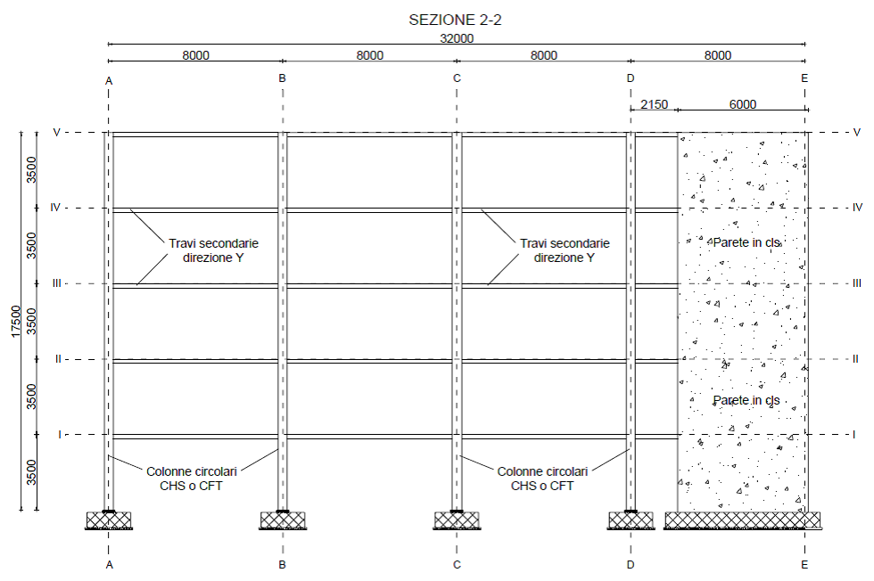
Trento, 02 December 2020
Ph.D. Student: Chiara Nardin
chiara.nardin@unitn.it
Introduction | Probabilistic Hazard Analysis | Fragility Analysis | References
Step 1: the case study ATTEL⁽¹⁾
^{[1]}BURSI, PUCINOTTI, TONDINI, ZANON, Tests and model calibration of high strength steel tubular beam-to-column and column-base composite joints for moment-resisting structures, Earthquake Engineering and Structural Dynamics, (2015).
T₁ = 2.79 s
T₁ = 0.46 s
3D model of the case study ATTEL – SERA project.
Main sections of the moment resistent frame and the braced one.

Slide 23
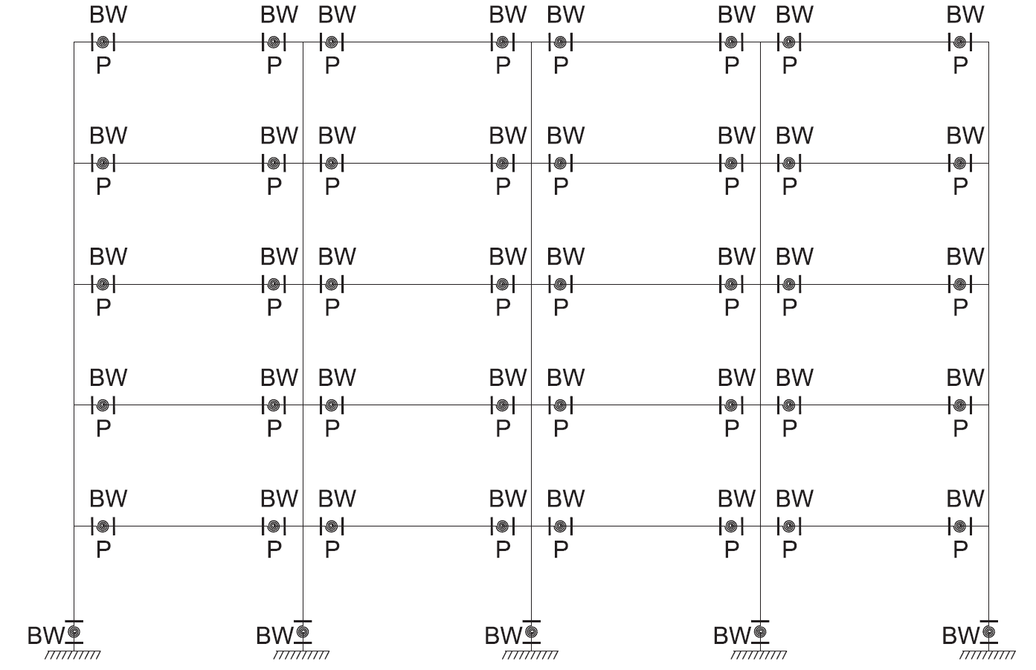
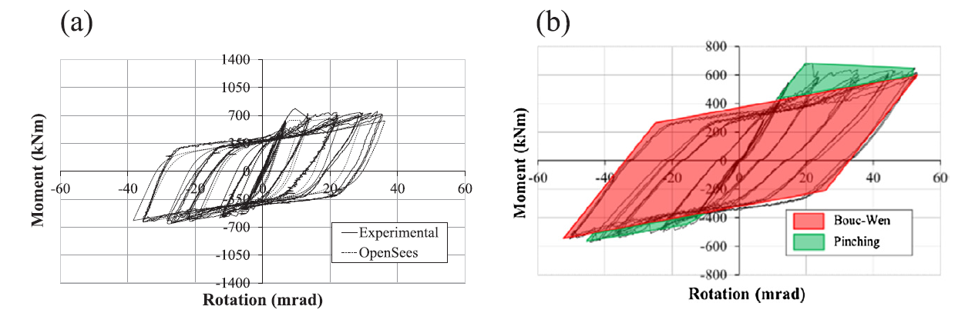
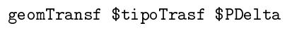
Trento, 02 December 2020
Ph.D. Student: Chiara Nardin
chiara.nardin@unitn.it
Introduction | Probabilistic Hazard Analysis | Fragility Analysis | References
Designed according to EC8 and modelled in OS:
beam and column elements with linear elastic behavior
mechanical nonlinearities
geometric nonlinearities
Model of the structure in OpenSees.

Slide 24
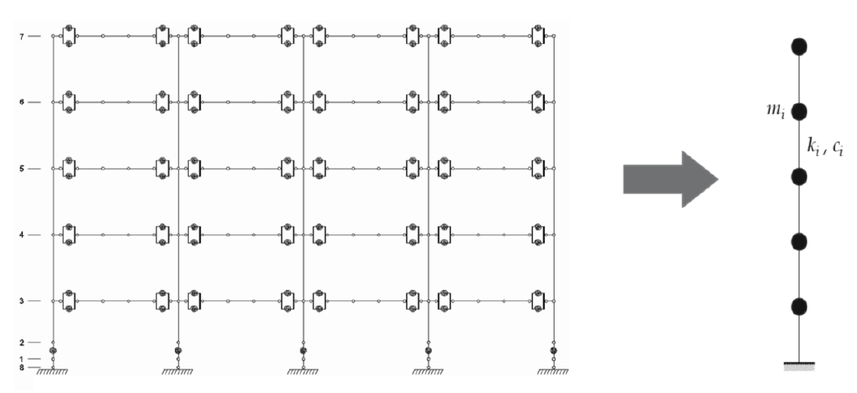
Trento, 02 December 2020
Ph.D. Student: Chiara Nardin
chiara.nardin@unitn.it
Introduction | Probabilistic Hazard Analysis | Fragility Analysis | References
to reduce computational burden
to reduce required simulation times
High number of analysis
for seismic simulations
Calibration oriented to correspondence of:
main periods
modes of vibrating
dissipative behavior
high fidelity model in OpenSees - OS
simplified model MDOF in MATLAB ® - ML

Slide 25
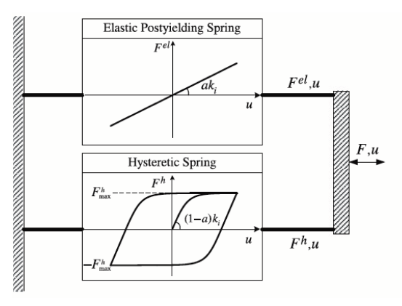
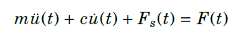



Trento, 02 December 2020
Ph.D. Student: Chiara Nardin
chiara.nardin@unitn.it
Introduction | Probabilistic Hazard Analysis | Fragility Analysis | References
Hysteretic model of Bouc Wen
Hysteretic model of Bouc Wen.
Formulation of the problem and examples of hysteretic cycles.

Slide 26



Trento, 02 December 2020
Ph.D. Student: Chiara Nardin
chiara.nardin@unitn.it
Introduction | Probabilistic Hazard Analysis | Fragility Analysis | References
Step 2: input and IM selection
Dataset NGA-WEST 2
206 ground motions
crustal earthquakes
M_{w} > 6
R_{rup} > 10 km
V_{s30} > 600 m/s
fault mechanism
reverse REV
strike slip SS
main features
IMs investigated
PGA [g]
PGV [cm/s]
PGD [cm]
Sa (T₁) [g rad²]
Sv (T₁) [cm rad/s]
Sd (T₁) [cm]
PSa (T₁) [g rad²]
PSv (T₁) [cm rad/s]

Slide 27



Trento, 02 December 2020
Ph.D. Student: Chiara Nardin
chiara.nardin@unitn.it
Introduction | Probabilistic Hazard Analysis | Fragility Analysis | References
Data exploration of recorded gms
Scatter plot and statistic tools to evaluate proper IM
Step 2: input and IM selection
Acceleration, velocity and displacement response spectra with mean value, 10^{-th} and 90^{-th} quantile.
Scatter plot for correlation.

Slide 28
Trento, 02 December 2020
Ph.D. Student: Chiara Nardin
chiara.nardin@unitn.it
Introduction | Probabilistic Hazard Analysis | Fragility Analysis | References
Step 2: input and IM selection
Codes:
%% Ground motions
Ground_motions = load('accelrot_cellarray.mat');
%
NN = [1, 2, 3, 4, 5, 6, 7, 8, 9, 10, 11, 12, 13, 14, 16, 17, 19, 21, 23, 24,...
25, 26, 28, 29, 30, 31, 32, 33, 34, 36, 37]; % number ID of the SS ground motions
DT = [0.01 , 0.01 , 0.005, 0.005, 0.005, 0.005, 0.02 , 0.02, 0.02, 0.01,...
0.01 , 0.01 , 0.02 , 0.02 , 0.02 , 0.02 , 0.02 , 0.02, 0.01, 0.01,...
0.005, 0.005, 0.005, 0.005, 0.02 , 0.005, 0.005, 0.01, 0.01, 0.01,...
0.01 , 0.005, 0.005, 0.02 , 0.005, 0.01 , 0.01]; % integration time step

Slide 29



Trento, 02 December 2020
Ph.D. Student: Chiara Nardin
chiara.nardin@unitn.it
Introduction | Probabilistic Hazard Analysis | Fragility Analysis | References
Step 3: Definition of damage limit states and reference EDP
MRF
BF
Document FEMA 356 - Prestandard and Commentary for the Seismic Rehabilitation of Buildings; Table C1-3 - Structural Performance Levels and Damage.

Slide 30
Trento, 02 December 2020
Ph.D. Student: Chiara Nardin
chiara.nardin@unitn.it
Introduction | Probabilistic Hazard Analysis | Fragility Analysis | References
Step 3: Definition of damage limit states and reference EDP
Codes:
%% MDOF Properties
% Choose between the structural system
MDOF_properties_BW_MRF
MDOF_properties_BW_BF
% and between linear or hysteretic behaviour
%% Structural behaviour
System_type = ‘le’; % ‘bw’
% bw = bouc-wen
% le = linear elastic
…
%% Limit States
LS = [0.50 0.75 1 2 3]*4/100;
for ls_i = 1:numel(LS)
ls_val = LS(ls_i)
Main_IDA_o_t
ls_i = ls_i + 1;
end

Slide 31
Trento, 02 December 2020
Ph.D. Student: Chiara Nardin
chiara.nardin@unitn.it
Introduction | Probabilistic Hazard Analysis | Fragility Analysis | References
Step 4: Performing non-linear time histories analysis
Codes:
%% Initial condition
Mat.dFe=zeros(Mat.NDOF,numel(a_g_norm)); % Preallocation for the load for the time series
a_g = a_g_norm*scale; % Scaled ground motion
Mat.Fe=Mat.M*Mat.r'*a_g'*g;
%% Computation response
[HistVarBw]=ResponceMDF_Bw(Mat);
edp = max(abs(HistVarBw.eps(1,:)));
EDP(i) = edp; %store the EDP for each time history analysis
SCALE(i) = scale; %store the scale factor for each time history analysis…

Slide 32

Trento, 02 December 2020
Ph.D. Student: Chiara Nardin
chiara.nardin@unitn.it
Introduction | Probabilistic Hazard Analysis | Fragility Analysis | References
Step 5: Computing fragilities
Codes:
%% Untruncated IDA
[parmhat,parmci] = lognfit(IM_t_c ,0.01);
mu_IDA = parmhat(1);
sigma_IDA = parmhat(2);
%% Truncated IDA
IM_max = 2.2;
IM_trunc = IM_t_c(IM_t_c < IM_max); % take only the results with IM < IM_max
eq_over = sum(IM_t_c >= IM_max); % number of analyses reached IM_max without collapsing
% Maximum likelihood fit, using equation (1) and (2) of previously slides
[mu_IDA_t, sigma_IDA_t ] = truncated_ida(IM_trunc, IM_max, eq_over);

Slide 33

Trento, 02 December 2020
Ph.D. Student: Chiara Nardin
chiara.nardin@unitn.it
Introduction | Probabilistic Hazard Analysis | Fragility Analysis | References
Step 5: Computing fragilities - Results

Slide 34

Trento, 02 December 2020
Ph.D. Student: Chiara Nardin
chiara.nardin@unitn.it
Introduction | Probabilistic Hazard Analysis | Fragility Analysis | References
Step 5: Computing fragilities - Results

Slide 35
Trento, 02 December 2020
Ph.D. Student: Chiara Nardin
chiara.nardin@unitn.it
References
Ph.D. Student Chiara Nardin – M.Sc., Eng. in Civil Engineering
https://github.com/kia13nn/ISPS.git

Slide 36
Trento, 02 December 2020
Ph.D. Student: Chiara Nardin
chiara.nardin@unitn.it
Introduction | Probabilistic Hazard Analysis | Fragility Analysis | References
References:
Baker J. W. (2008). An Introduction to Probabilistic Seismic Hazard Analysis (PSHA), White Paper, Version 1.3, 72 pp.
Kramer, S.L. (1996) Geotechnical earthquake engineering. Prentice Hall, Upper Saddle River, N.J.
Wells, D.L. and Coppersmith, K.J. (1994) New empirical relationships among magnitude, rupture length, rupture width, rupture area, and surface displacement. Bull. Seism. Soc. Am., 84, 974-1002.
Cornell, C.A. (1968). Engineering seismic risk analysis, Bull. Seism. Soc. Am., 58, 1583-1606.
Broccardo, M. (2018) Probabilistic seismic risk analysis for civil systems, Lecture Notes
Stucchi M., Meletti C., Montaldo V., Akinci A., Faccioli E., Gasperini P., Malagnini L., Valensise G. (2004). Pericolosità sismica di riferimento per il territorio nazionale MPS04. Istituto Nazionale di Geofisica e Vulcanologia (INGV). https://doi.org/10.13127/sh/mps04/agKramer, S.L. (1996) Geotechnical earthquake engineering. Prentice Hall, Upper Saddle River, N.J.
http://zonesismiche.mi.ingv.it/ → Italian database

Slide 37
Trento, 02 December 2020
Ph.D. Student: Chiara Nardin
chiara.nardin@unitn.it
Introduction | Probabilistic Hazard Analysis | Fragility Analysis | References
References:
Mackie, K & Stojadinovic, Bozidar. (2003). Seismic Demands for Performance-Based Design of Bridges.
Bursi, Pucinotti, Tondini, Zanon, Tests and model calibration of high strength steel tubular beam-to-column and column-base composite joints for moment-resisting structures, Earthquake Engineering and Structural Dynamics, (2015).
Broccardo, M. (2018) Probabilistic seismic risk analysis for civil systems, Lecture Notes
Charalampakis, A. & Koumousis,V. (2010). Parameters of Bouc–Wen Model Revisited, Applied Mechanics.
Haukaas, T. & Der Kiureghian, A. (2004). Finite Element Reliability and Sensitivity Methods for Performance-Based Earthquake Engineering, tech. rep., PEER - Pacific Earthquake Engineering Research Center.

Slide 38
Trento, 02 December 2020
Ph.D. Student: Chiara Nardin
chiara.nardin@unitn.it
Thanks for the attention!
Ph.D. Student Chiara Nardin – M.Sc., Eng. in Civil Engineering
https://github.com/kia13nn/ISPS.git

